Slide 1

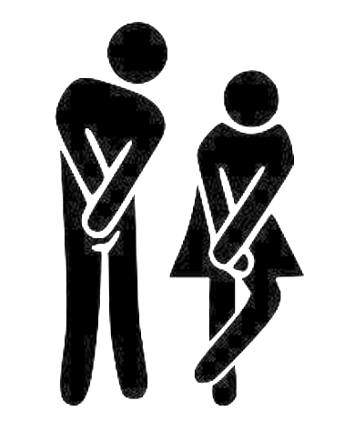
W200 Project 1
I Gotta Go!
Presented by: Heesuk Jang
MIDS, UC Berkeley
July 6, 2021
Traveling somewhere
you are unfamiliar with?
Out for the day in the city?

Slide 2
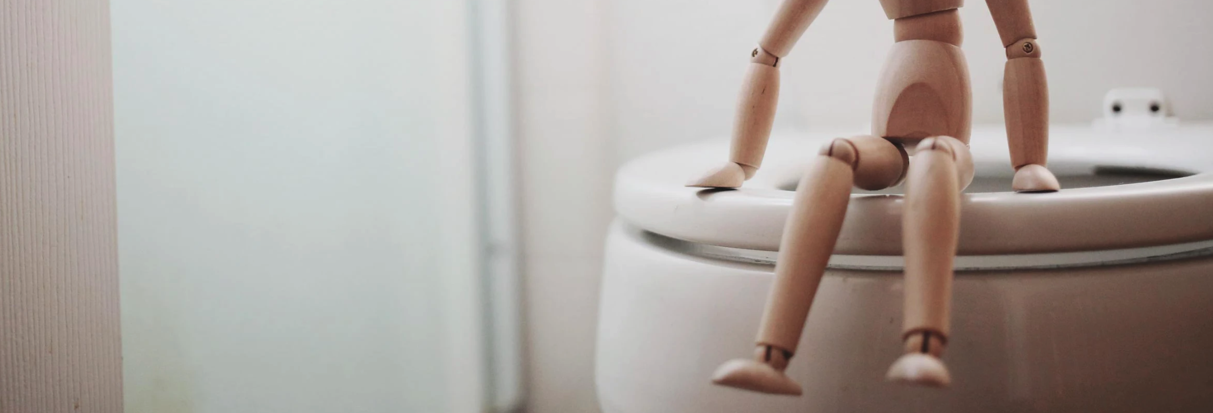

Objective and Technologies Used
OBJECTIVE
TECHONOLOGIES
To help people not only find a nearby public bathroom but also one in their specific needs, whether it is unisex, ADA accessible or a bathroom with a changing table
BACKEND:
Python 3.8 / Flask GUI
FRONTEND:
Bootstrap CSS / Font Awesome
Notes:
Picture: burst.shopify.com

Slide 3

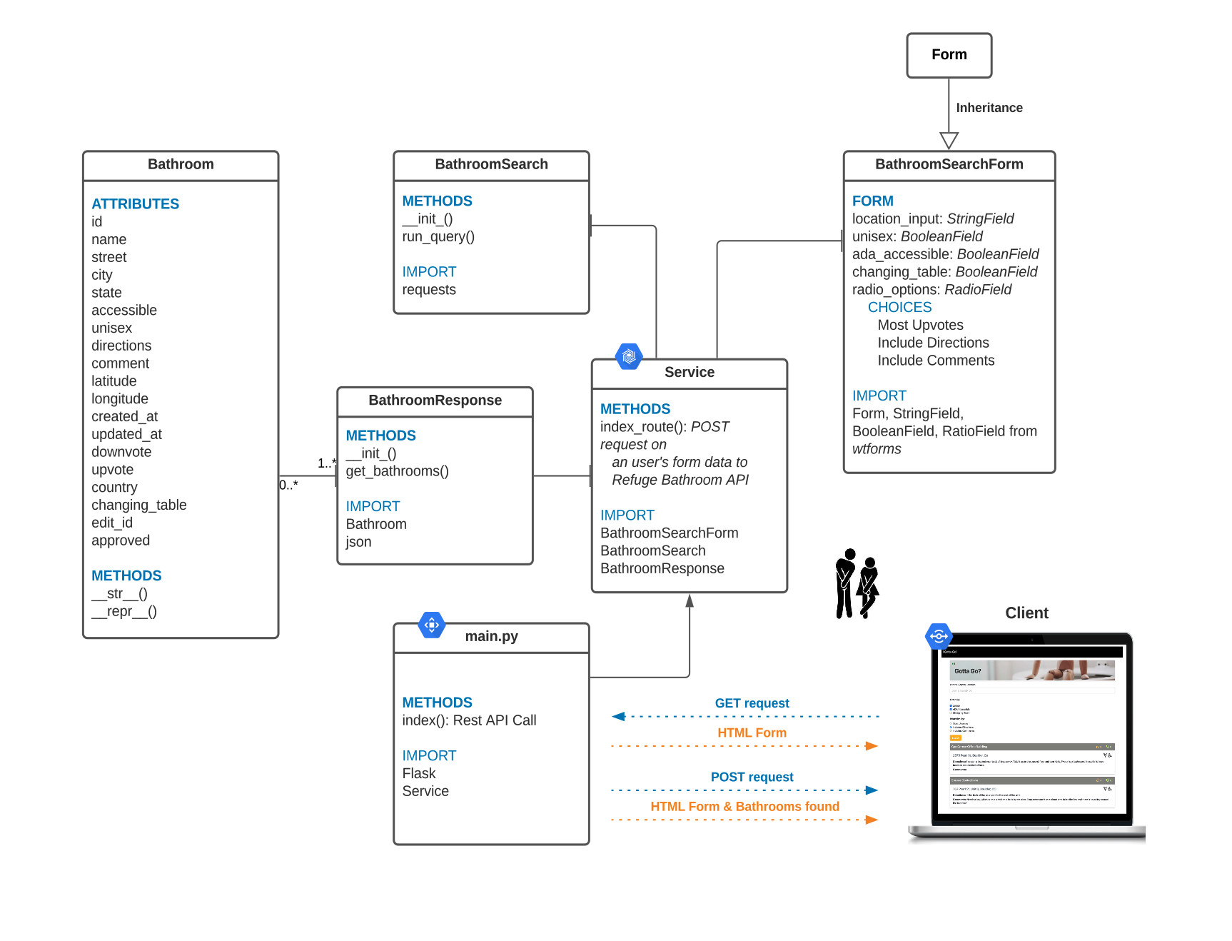
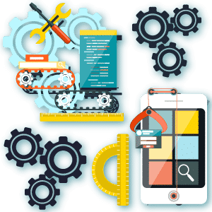

Class UML Diagram
3
Notes:
Picture: burst.shopify.com

Slide 4
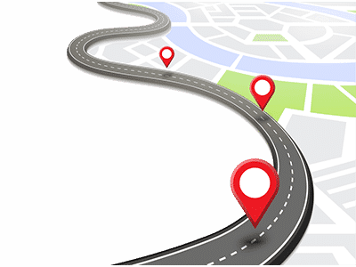
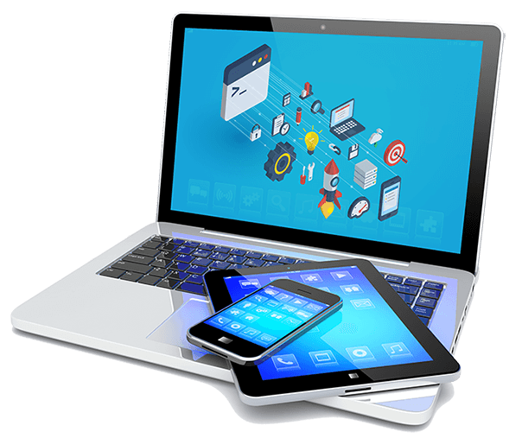
Sequence Diagram
4
Notes:
Picture: burst.shopify.com

Slide 5

Completed Features
Search for the nearest bathrooms by location text
Filter a list of the bathrooms by unisex, ADA accessible, and/or changing table
Prioritize the nearest bathrooms found by the most upvotes, directions to access the bathroom, or comments provided
Display the available accessibility of unisex, ADA accessible and/or changing table using icons for each bathroom location
Display the number of upvotes and downvotes with icons
Sync each bathroom location as a hyperlink that renders a Google map using the latitude and longitude of the bathroom
Display an error message if the user does not enter a search string
Display an error message if the request to get bathrooms from Refuge Restrooms API fails
5
5
Notes:
Picture: burst.shopify.com

Slide 6
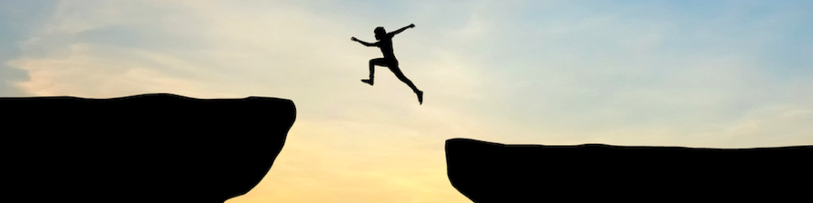
Challenges Faced
Python GUI development choosing an optimal Python framework
Preserving state of the users’ selected criteria
Getting the results from the Refuge Restrooms API and saving into Python
Setting up the interactions among every class
Setting up the state of the backend-frontend interaction
Notes:
Picture: burst.shopify.com

Slide 7

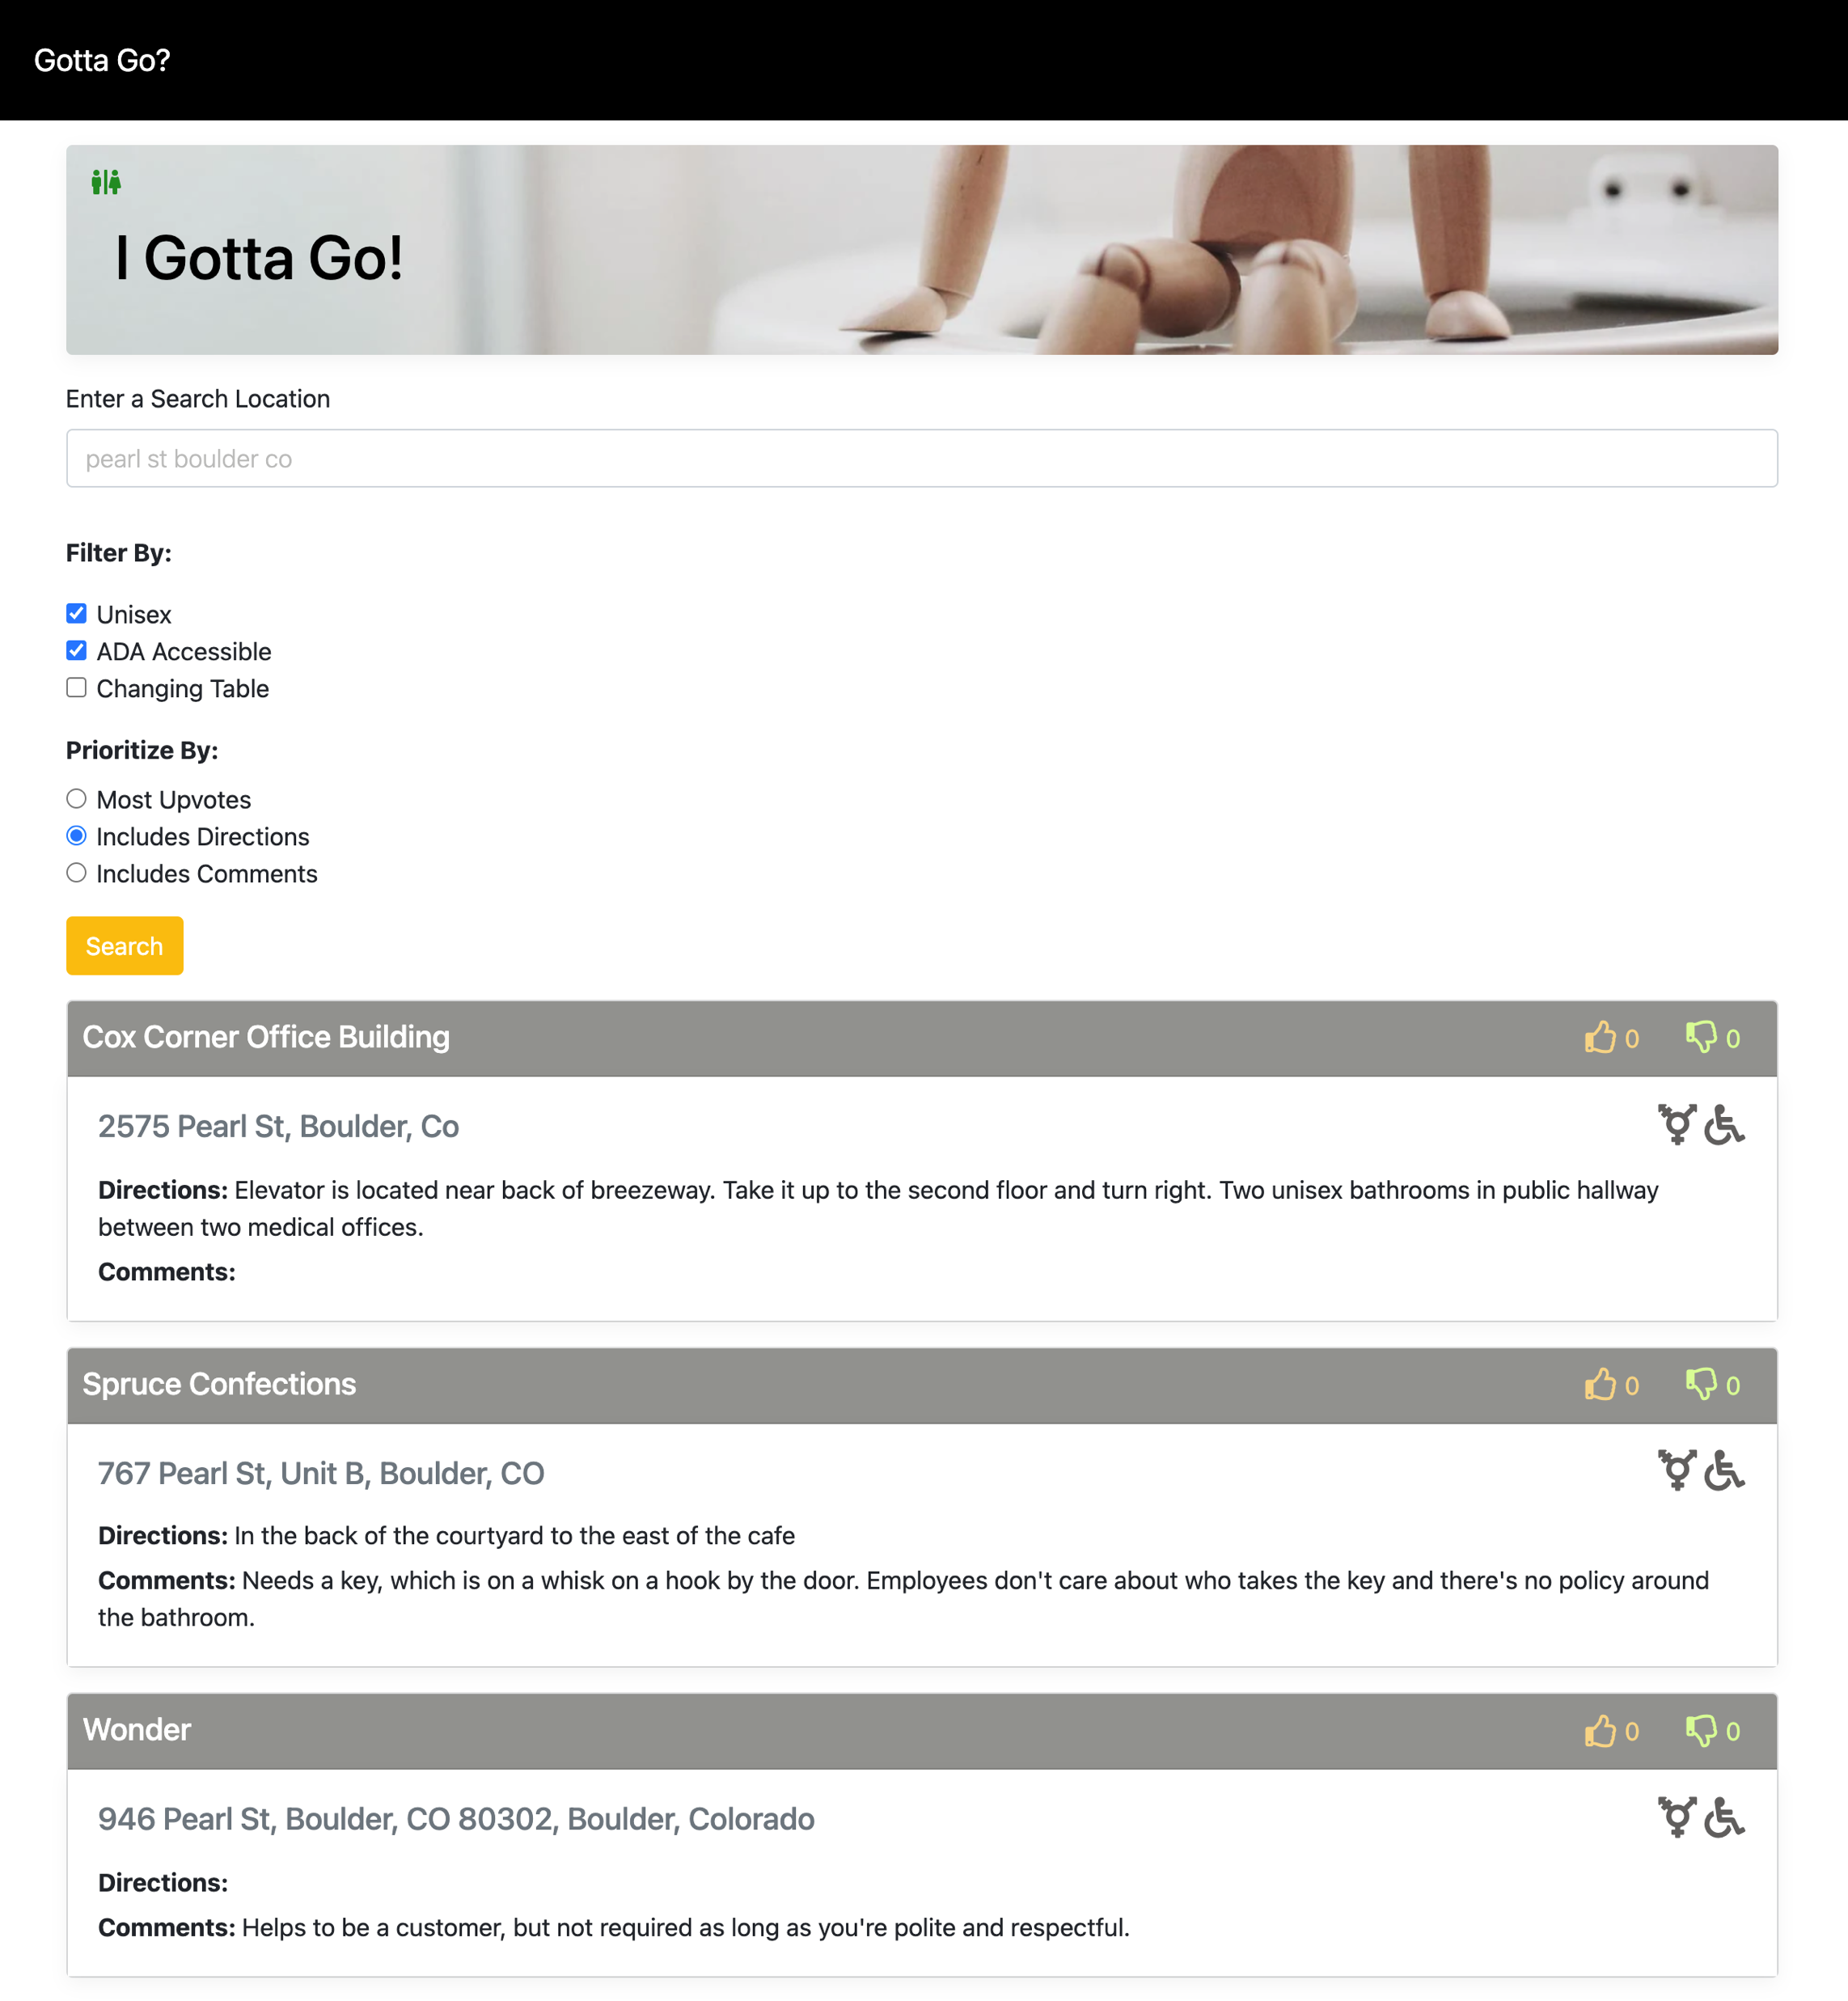
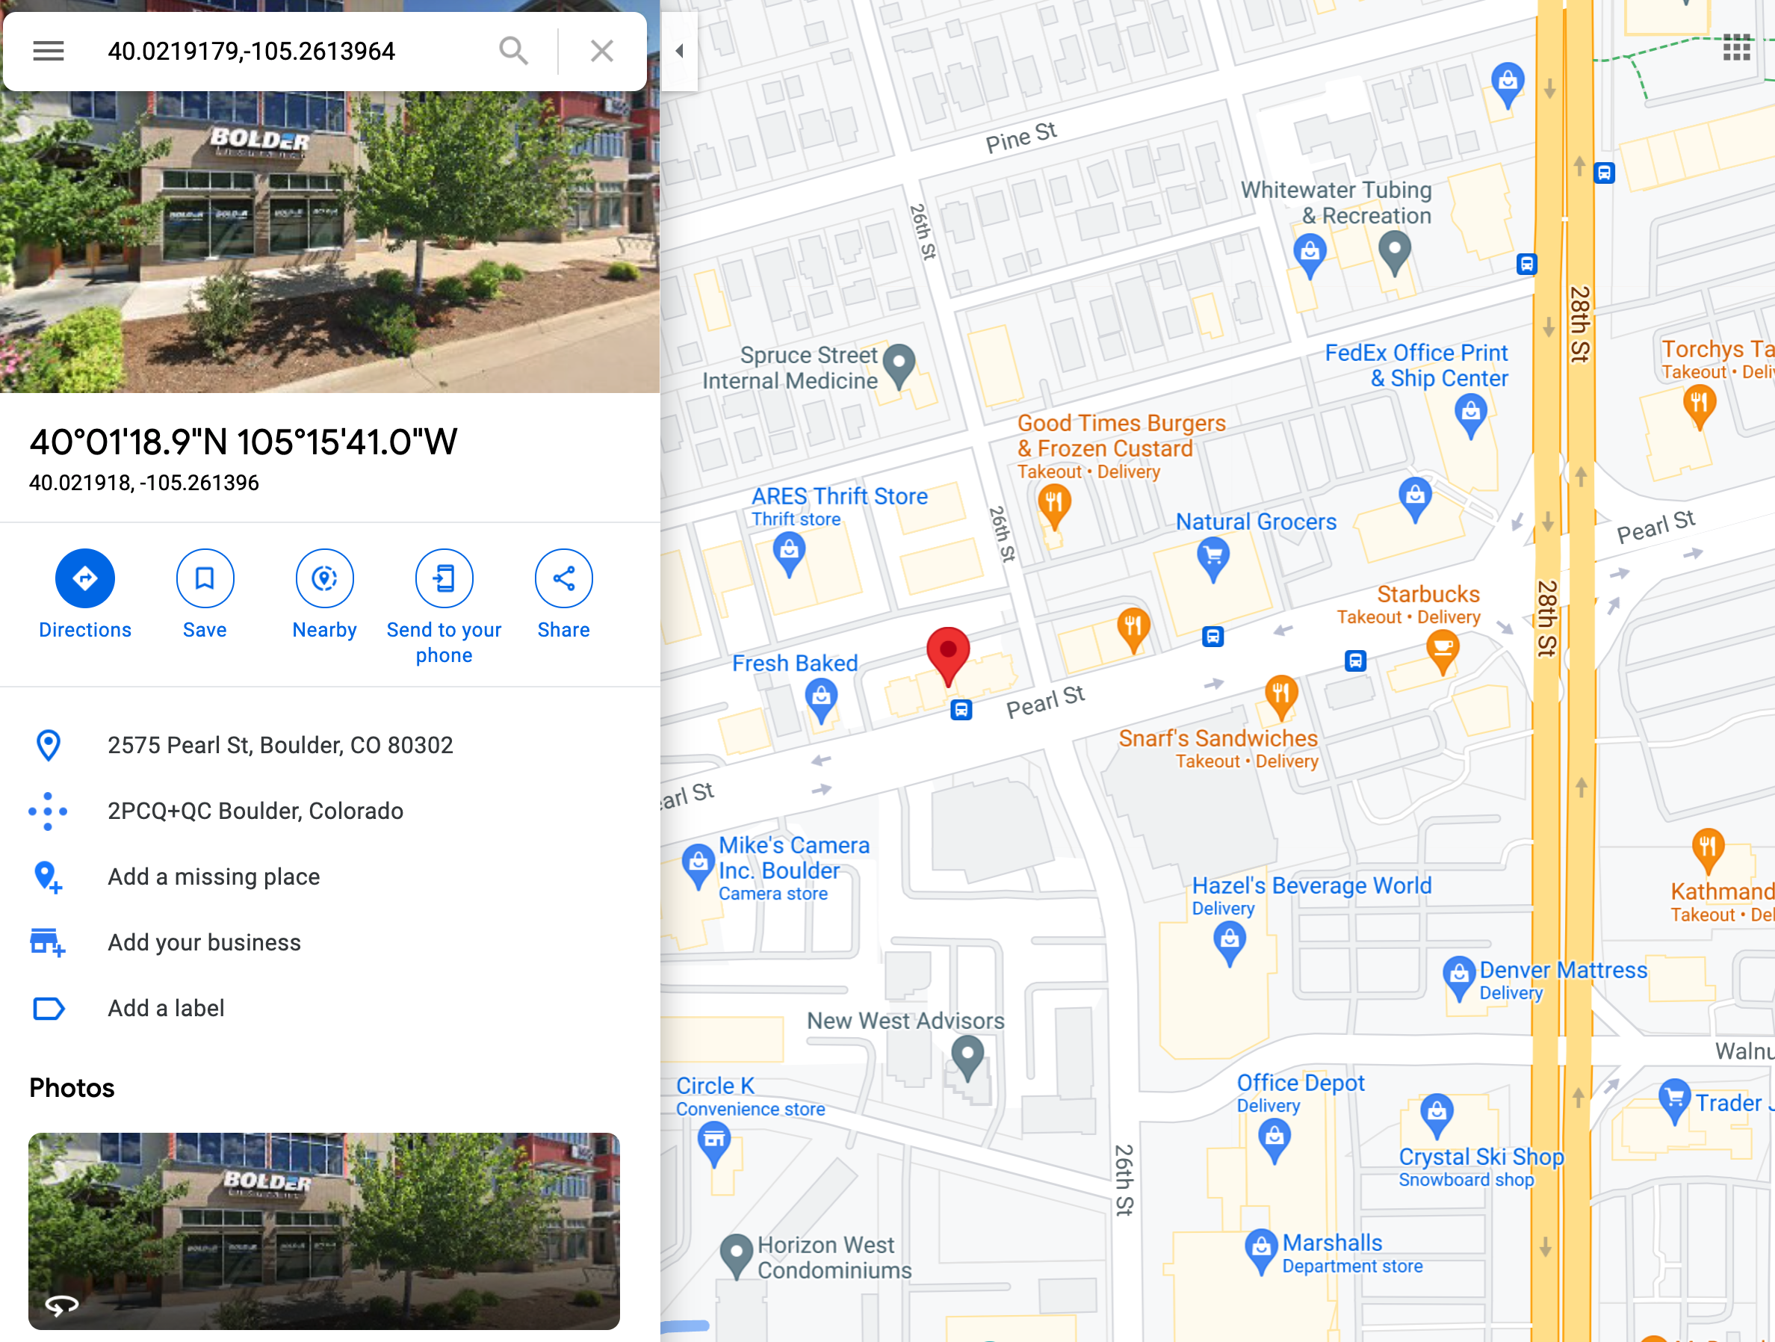
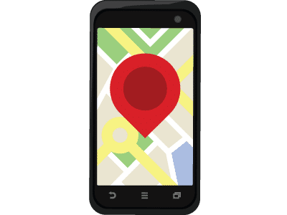
DEMO
7
Notes:
Picture: burst.shopify.com

